Slide 1
Universidade Federal de Alagoas
Instituto de computação
Programa de Pós-Graduação em Informática - PPGI
Another aproach to code smell detection: assessing interpretability of decision tree-based detections
Master Student: Christiano Rossini Martins Costa
Advisor: Baldoino Fonseca dos Santos Neto

Slide 2
Data Analysis
Research Question 1
RQ1 - To what extent are decision tree-based detections comprehensible/interpretable to developer?

Slide 3
Data Analysis
Research Question 2
RQ2 - How confident is the developer to apply the suggested detections to his context
RQ2 - (Based on participant rating) How correlated is an interpreted classification tree regarding to a specific code snippet ?

Slide 4
Data Analysis
Research Question 3
RQ3 - Participants' perception on specific code smell may influence intepretabilit/comprehensibility?

Slide 5
Data Analysis
Research Question 4
(?) RQ4 - What’s the relationship between effectivity and interpretability?

Slide 6
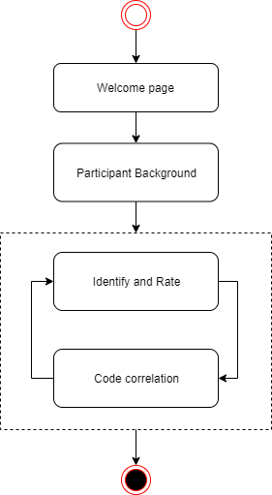
Survey design

Slide 7
Survey desing overview
Analyzed Code Smells | Questions | Varied Tree parameters | Values
God Class | Identify Tree | Number of Leaves (NoL) | [4,7,10]
Long Method | Rate Tree | Average Tree Depth | Depends on NoL
Class Data Should be private | Code correlation
Long Parameter List

Slide 8
Research schedule
Activity | Progress | Limit
Build datasets
Manipulate and Build Models
Collect Code snippets
Build Survey - develop django app to get data
Survey, validation |  | 20/11/2019
Publish and execute survey |  | 05/12
Prepare colected data |  | 09/12
Data analysis |  | 19/12
Finish article to submission |  | 15/01/2020
Finish dissertation document |  | 14/02/2020

Slide 9
Discussions

